Slide 2
Msgr. Gerard O’Connor
Director of the Office of Divine Worship

Slide 4
Genesis
Archbishop Sample
Survey of Other Dioceses
Desire for More Theology
Academic Sources & References
Emphasis on the Holy Eucharist
Ars Celebrandi

Slide 5
What is the ALH?
Theological Treatment of the Sacred Liturgy
Treatise on the Celebration Most Holy Eucharist
Description of the Various Rites of the Church
Collection of Norms, Legislation, Best Practice and Preferences
Universal Norms & Local Norms
Vision for Liturgical Excellence

Slide 6
Audience
Priests & Deacons
Pastoral Associates
Seminarians
Students of Liturgy
Liturgy Coordinators
Anyone Interested in the Worship of the Church

Slide 7
Format
PDF – Divine Worship
Amazon
Kindle
Print
Original Copies
Devised as an Electronic Document
385 Pages
137,118 Words
20 Chapters
1,922 Footnotes
114 Cited Texts

Slide 8
Definition of Liturgy
The Liturgy – The Work of the Holy Spirit
The word Liturgy originally meant a ‘public work’ or a “service in the name of/on behalf of the People of God.”
In Christian tradition it means the participation of the People of God in “the work of God.” Through the liturgy Christ, our redeemer and high priest continues the work of our redemption in, with, and through his Church. (CCC 1069)

Slide 11
Council of Trent
1545 - 1563
Four Important Issues
Celibacy
Veneration of Images
Communion under Both Species
Vernacular in the Liturgy

Slide 12
Liturgical Principle
“The Church did not begin in 1964 nor did the rich patrimony of its Liturgy.”
- Msgr. G O’Connor

Slide 13
Second Vatican Council
Liturgical Movement – Started in 1850s
Pope St. Pius X – Sacred Music
Pope Pius XII – Holy Week, Reform of the Breviary, Psalter, Mediator Dei 1947
Pope St. John XXIII 1960 Calendar and 1962 Missal

Slide 14
Second Vatican Council
Sacrosanctum Concilium – 4 December 1963
Motu Proprio Sacram Liturgiam 25 January 1964
Consilium Ad Exsequendam Consitutionem de Sacra Liturgia
First Instruction (of five)
Inter Oecumenici – On the Orderly Carrying Out of the Constitution on the Liturgy, 26 September 1964

Slide 15
Second Vatican Council
Tres abhinc annos (4 May 1967), which established further adaptation of the Order of Mass.
Liturgicae instaurationes (5 September 1970), which contained directives regarding the central role of the Bishop in the renewal of the Liturgy in all the dioceses.
Varietates legitimae (28 January 1994), which treated the difficult questions about the Roman Liturgy and inculteration.
The fifth was more recent and concerned the translation of liturgical texts.
Liturgiam Authenticam (28 March 2001)

Slide 16
Active Participation
Times Mentioned in Sacrosanctum Concilium
Active Participation 12
Sacrifice 9
Meal 0
Mass 44
Eucharist 12

Slide 17
Active Participation
“After Vatican II some people unfortunately thought that they had to be creative. As I’ve said more than once, I have never understood why people who have never manifested the slightest creativity in any other aspect of their human existence all of the sudden think they’re Shakespeare or Mozart when it comes to the liturgy. That’s sheer arrogance.”
Robert Taft SJ
U.S. Catholic December 2009

Slide 18
Active Participation
“What you get out of the liturgy is the privilege of glorifying almighty God. If you think it’s about you, stay at home. It’s not about you. It is for you, but it’s not about you.”
Robert Taft SJ
U.S. Catholic December 2009

Slide 19
Active Participation
“Intense effort must be brought to bear on the agreement between of the lex orandi with the lex credendi, so that in its meaning prayer preserves the riches of dogma.”
Pope St. Paul VI
Address to the Consilium 13 October 1966

Slide 20
Liturgical Principles
General Norms
1. Regulation of the sacred liturgy depends solely on the authority of the Church, that is, on the Apostolic See and, as laws may determine, on the bishop.
2. In virtue of power conceded by the law, the regulation of the liturgy within certain defined limits belongs also to various kinds of competent territorial bodies of bishops legitimately established.
3. Therefore no other person, even if he be a priest, may add, remove, or change anything in the liturgy on his own authority.
[Sacrosanctum Concilium 22]

Slide 21
Outline of the ALH
An Outline of the ALH

Slide 22
Letter From the Archbishop
This Archdiocesan Liturgical Handbook is intended to serve as a guide to many of the aspects of the life of our diocese and our parishes that concern the celebration of the Sacred Liturgy and the understanding of the faith it expresses.
This Archdiocesan Liturgical Handbook is intended to be a living document which guides and steers the liturgical praxis within our Archdiocese, as such it will be updated on a regular basis according to the additions, modifications and revisions to the Rites of the Church and the documents issued from the Holy See pertaining to the Sacred Liturgy.

Slide 23
Letter From the Archbishop
It goes without saying that pastors and those with formal responsibilities in the Archdiocese will implement the norms, policies and preferred practice contained here as a conscientious duty. When this involves introducing changes in previous practice, pastors should be patient in carefully and loyally explaining to the faithful the theology and reasons underlying these changes.
I call to mind a sentence of St. John Paul II, from his 2003 Encyclical Letter on the Most Holy Eucharist, where he writes “The Eucharist is too great a gift to tolerate ambiguity and depreciation” (Ecclesia de Eucharistia, 10).

Slide 25
Preamble A Panorama of Faith in the Sacraments

Slide 26
Preamble
Sacramentum Caritatis – Pope Benedict XVI
Post-synodal Apostolic Exhortation of
the Holy Father on the Eucharist as the Source and Summit of the Church’s Life and Mission
- 22 February 2007

Slide 27
The mystery of the Eucharist is the great “mystery of faith,” “the sum and summary of our faith,” “a mystery of Trinitarian love,… in which we are called by grace to participate.” In fact, “God is a perfect communion of love between Father, Son and Holy Spirit” and “it is in Christ, who died and rose again, and in the outpouring of the Holy Spirit, given without measure (cf. Jn 3:34), that we have become sharers of God’s inmost life.”

Slide 28
Yet there is another great command, the very greatest, given at the Last Supper, “do this in memory of me,” by which “he asks us to respond to his gift and to make it sacramentally present.” This, as we have already seen, is the entire program for our life and work, embracing all the rest.

Slide 29
Outline of the ALH
Part One
The Most Holy Eucharist

Slide 30
Introduction
The Most Holy Eucharist, “stands at the center of the Church’s life”, since it truly “contains the Church’s entire spiritual wealth: Christ himself, our Passover and Living Bread.” “The Church has received the Eucharist from Christ her Lord not as one gift -however precious - among so many others, but as the gift par excellence, for it is the gift of himself, of his person in his sacred humanity, as well as the gift of his saving work.” That surpassing gift of the Eucharist is where the Church draws her life, the dynamic force of all her activity and her whole sense of purpose and direction. As the Second Vatican Council proclaimed, the Eucharistic sacrifice is “the source and summit of the Christian life”. [1.1.1]

Slide 31
Introduction
The celebration of the Mass is the action of Christ and the People of God arrayed hierarchically. It is the center of the whole Christian life for the Church both universal and local, as well as for each of the faithful individually. In it is found the high point both of the action by which God sanctifies the world in Christ and of the worship that the human race offers to the Father, adoring him through Christ, the Son of God, in the Holy Spirit. In it, moreover, during the course of the year, the mysteries of redemption are recalled so as in some way to be made present. Furthermore, the other sacred actions and all the activities of the Christian life are bound up with it, flow from it, and are ordered to it. [1.1.2]

Slide 32
Introduction
It is therefore of the greatest importance that the celebration of Holy Mass be so arranged that the sacred ministers and the faithful taking part in it, according to the proper state of each, may derive from it more abundantly those fruits for the sake of which Christ the Lord instituted the Eucharistic sacrifice of his Body and Blood and entrusted it to the Church, his beloved Bride, as the memorial of his Passion and Resurrection. [1.1.3]

Slide 33
The Role of the Archbishop
However, every legitimate celebration of the Eucharist in the Archdiocese of Portland in Oregon without exception is directed by the Archbishop, either in person or through priests who are his helpers. [1.2.2]
GIRM 92; LG 26, 28; SC 42.

Slide 34
Celebration of the Holy Eucharist
C. The Faithful People
General
Movement and Posture
Genuflections and Bows
Other Gestures
Additional Gestures and Postures
Silence

Slide 35
Celebration of the Holy Eucharist
C. The Faithful People
General
Movement and Posture
Genuflections and Bows
Other Gestures
Additional Gestures and Postures
Silence

Slide 37
Liturgical Principle
Unless approved for the Universal Church by the Holy See or for the local Church by the competent Bishop’s Conference, other gestures and postures cannot be admitted to the Sacred Liturgy. Liturgical law is prescriptive in nature and therefore the absence of a prohibition does not allow for innovation.
[ALH 1.14.1]

Slide 38
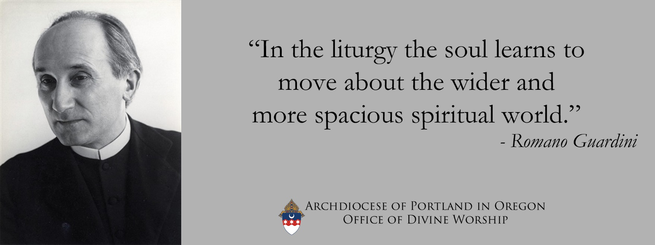

Slide 39
Celebration of the Holy Eucharist
D. Ministries and Offices of Lay Faithful
Proper Understanding of Certain Roles of Faithful Laypeople
Instituted Acolytes
Altar Servers
Instituted Lectors
Readers Extraordinary Ministers of Holy Communion
Musicians, Singers, and Choir Members

Slide 40
CHAPTER 2 - PONTIFICAL CELEBRATION OF THE EUCHARIST
As “the chief steward of the mysteries of God in the particular Church entrusted to his care,” the diocesan bishop is “the moderator, promoter, and guardian of the whole of its liturgical life.” For “the bishop, endowed with the fullness of the Sacrament of Holy Orders, is ‘the steward of the grace of the High Priesthood’, especially in the Most Holy Eucharist which he either himself offers or causes to be offered and by which the Church continually lives and grows.” [2.1.2]

Slide 42
CHAPTER 2 - PONTIFICAL CELEBRATION OF THE EUCHARIST
Indeed, the pre-eminent manifestation of the Church is found whenever the rites of Mass are celebrated “with the full and active participation of the entire holy People of God, joined in one act of prayer, at one altar at which the bishop presides”, surrounded by his priests and deacons. [2.1.3]

Slide 43
Chapter 3 - Sunday Parish Celebration of the Holy Eucharist
The celebration of the Mass is the action of Christ and the People of God hierarchically arrayed. It is the center of the whole Christian life for the Church both universal and local. In it is found the high point both of the action by which God sanctifies the world in Christ and of the worship that the human race offers to the Father, adoring him through Christ, the Son of God, in the Holy Spirit. [3.1.2]

Slide 44
Chapter 3 - Sunday Parish Celebration of the Holy Eucharist
Such a parish celebration of Holy Mass is in no way separate from the authority of the Archbishop but, like every legitimate celebration of the Eucharist in the Archdiocese of Portland in Oregon without exception, is directed by him, usually through the pastor and other priests who are the Archbishop’s helpers, but from time to time by the Archbishop in person. [3.1.5]

Slide 46
Chapter 3 - Sunday Parish Celebration of the Holy Eucharist
The celebration of the Eucharist in Holy Mass is an action of Christ and the Church, the whole of the faithful people Christ Jesus has gathered to himself. [3.9.1]

Slide 47
Chapter 3 - Sunday Parish Celebration of the Holy Eucharist
Within this “Eucharistic community”, a solemn duty lies with the pastor “to see to it that the Most Holy Eucharist is the center of the parish congregation of faithful. [3.10.3 cf. CIC 528]

Slide 48
Chapter 4 - Reception of Holy Communion
Full participation in the Eucharist takes place when the faithful receive Holy Communion, yet care must be taken lest they conclude that the mere fact of their being present during the liturgy gives them a right or obligation to receive Communion. Even when it is not possible to receive Communion, participation at Mass remains necessary, important, meaningful and fruitful. [4.1.1]

Slide 50
Chapter 4 - Reception of Holy Communion
In order for Holy Communion under both species to be administered to the lay members of Christ’s faithful, due consideration should be given to the circumstances, as judged first of all by the Archbishop. The Holy See requires that it is to be completely excluded where even a small danger exists of the sacred species being profaned. [4.4.4]

Slide 51
Chapter 5 - Reservation and Veneration of the Blessed Sacrament
The celebration of the Eucharist in the Sacrifice of the Mass is truly the origin and end of the worship given to the Eucharist outside the Mass. Furthermore the sacred species are reserved after Mass principally so that the faithful who cannot be present at Mass, above all the sick and those advanced in age, may be united by sacramental Communion to Christ and his Sacrifice which is offered in the Mass. [5.1.1]
In addition, this reservation also permits the practice of adoring this great Sacrament and offering it the worship due to God. Accordingly, forms of adoration that are not only private but also public and communitarian in nature, as established or approved by the Church herself, must be greatly promoted. [5.1.2]

Slide 52
Chapter 5 - Reservation and Veneration of the Blessed Sacrament
No one may carry the Most Holy Eucharist to his or her home, or to any other place contrary to the norm of law. It should also be borne in mind that removing or retaining the consecrated species for a sacrilegious purpose or casting them away are graviora delicta (the most serious crimes), the absolution of which is reserved to the Congregation for the Doctrine of the Faith. [5.1.9]

Slide 53
Outline of the ALH
Part Two
Sacraments Related to Christian initiation

Slide 54
Part Two – Sacraments Related to Christian initiation
6. Christian Initiation of Adults and Children of Catechetical Age
7. Baptism of Infants
8. Penance
9. Confirmation
10. First Holy Communion of Children

Slide 55
Outline of the ALH
Part Three
Other Sacraments

Slide 56
Part Three – Other Sacraments
11. Marriage
12. Anointing of the Sick

Slide 57
Outline of the ALH
Part Four
Other Liturgical
Celebrations

Slide 58
Part Four – Other liturgical Celebrations
13. Liturgy of the Hours
14. Funerals
15. Sacramentals
16. Extraordinary Form

Slide 59
Outline of the ALH
Part Five
Some Particular Matters

Slide 60
Part Five – Some Particular Matters
17. Times of the Liturgical Year and Feasts
18. Popular Piety
19. Eastern Christians
20. Particular Matters of Liturgical and Pastoral Practice

Slide 62
Summary
Comprehensive Treatment of Liturgical Practice
Help to Grow Devotion and Reverence
Foster a Greater Interest in the Sacred Liturgy
Encourage Discussions about Liturgical Applications
Uniform Approach to Celebrations
Promote the Vision of the Chief Liturgist
“More Reverent, Beautiful and Prayerful Experience of the Sacred Liturgy for the Faithful of the Archdiocese.”

Slide 64
Liturgical Principles
Gestures and Bodily Posture
The gestures and bodily posture of both the Priest, the Deacon, and the ministers, and also of the people, must be conducive to making the entire celebration resplendent with beauty and noble simplicity, to making clear the true and full meaning of its different parts, and to fostering the participation of all. Attention must therefore be paid to what is determined by this General Instruction and by the traditional practice of the Roman Rite and to what serves the common spiritual good of the People of God, rather than private inclination or arbitrary choice.
[GIRM 42]

Slide 65
Liturgical Principles
No one in the Archdiocese, including the Archbishop, has the authority to add to, subtract from or change the words of the Mass, either sung or recited.
[Cf. SC 22; CIC 838; GIRM 24]

Slide 66
Liturgical Principles
This is an important discussion to have, since so often the music selected for Mass is reduced to a matter of subjective “taste,” i.e. what style of music appeals to this or that person or group, as if there were no objective principles to be followed. There are indeed objective principles worthy of study and proper implementation, as will be shown.
[Sing to the Lord a New Song]

Slide 67
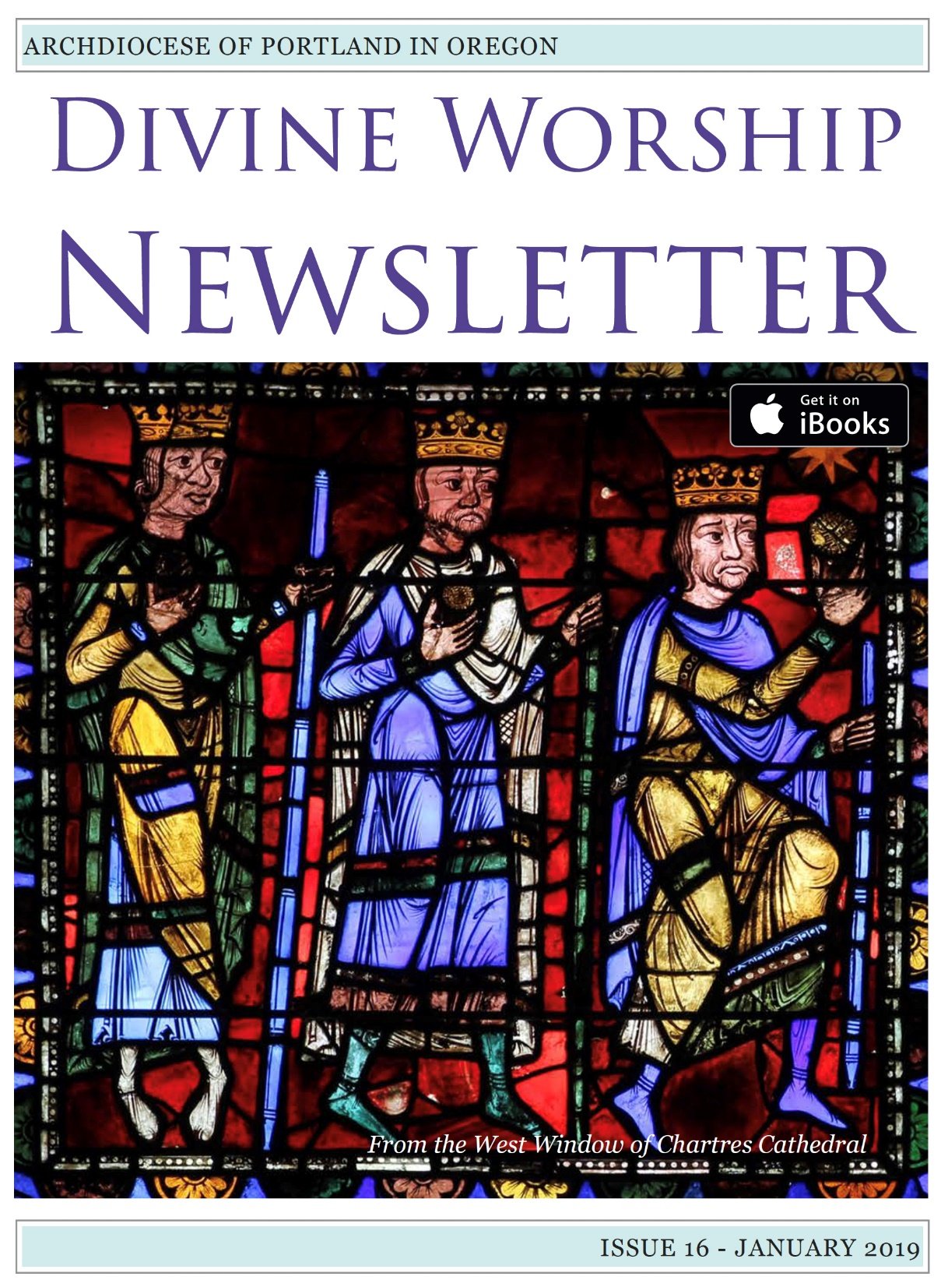
Pastoral Letter on Sacred Music
in Divine Worship
“Sing to the LORD a New Song”
of the Archbishop of Portland in Oregon
the Most Reverend Alexander K. Sample
to the Priests, Deacons, Religious,
Musicians and Faithful of the Archdiocese

Slide 68
A Quarterly Publication for
Extraordinary Ministers of Holy Communion
In the Archdiocese of Portland

Slide 69
Pastoral Letter on Sacred Music
in Divine Worship
“Sing to the LORD a New Song”
of the Archbishop of Portland in Oregon
the Most Reverend Alexander K. Sample
to the Priests, Deacons, Religious,
Musicians and Faithful of the Archdiocese

